Slide 1
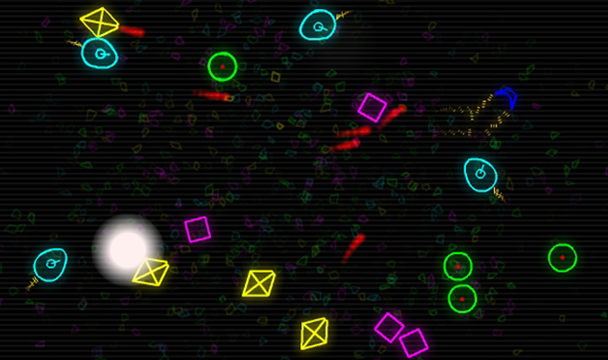
Dodge game
Green University of Bangladesh

Slide 2
Presented to
Ms. Ayesha Khatun
Department of CSE
Green University of Bangladesh
<number>

Slide 3
Presented by
Sayed Hasan Emon 221002051
<number>

Slide 4
Contents
Introduction of the project
What The Project offers
Conclusion
<number>

Slide 5
Dodge Game The project is all about making a simple game where anyone canhave a good time playing the simple game
1

Slide 6
The Interface (Still in development)
2

Slide 7
The Feathers added so far -
Health Added
Added Keyboard Support with auto key detection
Health bar can take damages
The enemy can move randomly
Graphical User Interface
Added Frames 60 fps
<number>

Slide 8
Add Feathers in Future
Add music
Improve the Gameplay
Better Graphical User Interface
Bug fixes
<number>

Slide 9
THANK YOU!
Anyone have any questions?
<number>

